Slide 1
CHAPTER 1
Overview of Financial Management & Financial Environment

Slide 2
Topics in Chapter
Forms of business organization
Objective of firm: Maximize wealth
Determinants of fundamental value
Financial securities, markets & institutions

Slide 3
Why is corporate finance important to all managers?
Corporate finance provides skills managers need to:
Identify & select corporate strategies & projects that add value to their firm.
Forecast funding requirements of their company, & devise strategies for acquiring those funds.

Slide 4
What 3 Questions Does Fin. Mgmt Seek to Answer?
What causes company to have particular stock value?
How can managers make choices that add value to their companies?
How can managers ensure their companies don’t run out of cash while executing their plans?
DUTY of co.’s Financial staff:
To acquire & use fund$ to Max value of Co.

Slide 5
Value of a business likely to be maximized when:
Firm lowers risk, thus increasing its value.
It optimizes growth opportunities, which depends on firm’s ability to attract capital.
Its stock is easily converted to cash (highly liquid)
All 3 of above are strongest under corporate structure of business organization

Slide 6
Factors affecting stock price:
Projected cash flows to shareholders.
Timing of CF stream.
Riskiness of CFs.
All Corp. decisions should be analyzed in term of their effects on these factors.

Slide 7
Factors that affect level & riskiness of CFs
INTERNAL:
Decisions made by Financial Mgrs.
Investment decisions
Financing decisions
Dividend Policy decisions
Operating Decisions
Operating determinants of CFs:
Sales: current vs. S/T vs. L/T
Operating vs. Capital Expenses
Think Profit Margin Perspective

Slide 8
Factors that affect level and riskiness of CFs
EXTERNAL:
Level of economic activity
tax laws
legal considerations
interest rates
Federal Reserve policies
Budget deficits/surpluses
Level of business activity (recession or boom)
Foreign trade deficits/surpluses
international trade
Market conditions
Competitive & financial

Slide 9
Business Organization from Start-up to a Major Corporation
Sole proprietorship
Partnership
Corporation

Slide 10
Starting as a Proprietorship
Advantages:
Ease of formation
Subject to few regulations
No corporate income taxes
Disadvantages:
Limited life
Unlimited liability
Difficult to raise capital to support growth

Slide 11
Starting as or Growing into a Partnership
Partners have agreement specifying how profits shared.
A partnership has roughly same advantages & disadvantages as a sole proprietorship.

Slide 12
Corporation vs. Partnership
Corporation
Partnership
Liquidity
Shares can be easily exchanged
Subject to substantial restrictions
Voting Rights
Usually each share gets one vote
General Partner is in charge; limited partners may have some voting rights
Taxation
Double
Partners pay taxes on distributions
Reinvestment & dividend payout
Broad latitude
All net cash flow is distributed to partners
Liability
Limited liability
General partners may have unlimited liability; limited partners enjoy limited liability
Continuity
Perpetual life
Limited life

Slide 13
Becoming a Corporation
A corporation is a legal entity separate from its owners & managers.
File papers of incorporation with state.
Charter
Bylaws

Slide 14
Advantages & Disadvantages of a Corporation
Advantages:
Unlimited life
Easy transfer of ownership
Limited liability
Ease of raising capital
Disadvantages:
Double taxation
Cost of set-up & report filing

Slide 15
Becoming a Public Corporation & Growing Afterwards
Initial Public Offering (IPO) of Stock
Raises cash
Allows founders & pre-IPO investors to “harvest” some of their wealth
Subsequent issues of debt & equity

Slide 16
Agency Problems & Corporate Governance
Agency problem: managers may act in their own interests & not on behalf of owners (stockholders)
Corporate governance is set of rules that control a company’s behavior towards its directors, managers, employees, shareholders, creditors, customers, competitors, & community.
Corporate governance can help control agency problems.

Slide 17
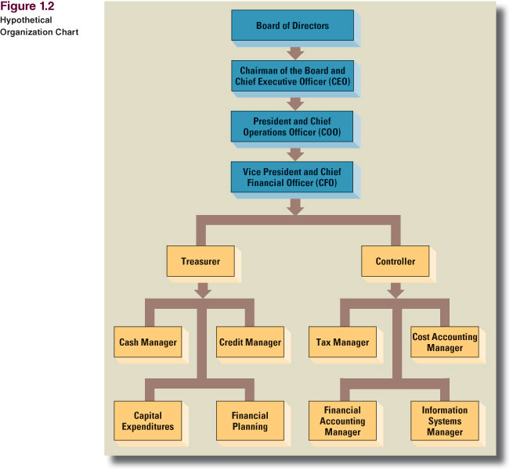
Corporate Organization: Finance Function

Slide 18
What should be management’s primary objective?
Primary objective should be shareholder wealth maximization, which translates to maximizing fundamental stock price.
Should firms behave ethically? YES!
Do firms have any responsibilities to society at large? YES! Shareholders are also members of society.

Slide 19
Is maximizing stock price good for society, employees, & customers?
Employment growth is higher in firms that try to maximize stock price. On average, employment goes up in:
Firms that make managers into owners (such as LBO firms)
firms that were owned by government but have been sold to private investors

Slide 20
Is maximizing stock price good? (Cont’d)
Consumer welfare is higher in capitalist free market economies than in communist or socialist economies.
Fortune lists most admired firms. In addition to high stock returns, these firms have:
High quality rating from customers’ view
Satisfied employees who like working there

Slide 21
What three aspects of cash flows affect an investment’s value?
Amount of expected cash flows (bigger is better)
Timing of cash flow stream (sooner is better)
Risk of cash flows (less risk is better)

Slide 22
Free Cash Flows (FCF)
Free cash flows are cash flows that are available (or free) for distribution to all investors (stockholders & creditors).
FCF = sales revenues - operating costs - operating taxes - required investments in operating capital.

Slide 23
What is weighted average cost of capital (WACC)?
WACC is average rate of return required by all of company’s investors.
WACC is affected by:
Capital structure (firm’s relative use of debt & equity as sources of financing)
Interest rates
Risk of firm
Investors’ overall attitude toward risk

Slide 24
What determines a firm’s fundamental, or intrinsic, value?
Intrinsic value is sum of all future expected free cash flows when converted into today’s dollars:
= NPV of firm’s discounted FCFs

Slide 25
Who are providers (savers) & users (borrowers) of capital?
Households: Net savers
Non-financial corporations: Net users (borrowers)
Governments: U.S. governments are net borrowers, some foreign governments are net savers
Financial corporations: Slightly net borrowers, but almost breakeven

Slide 26
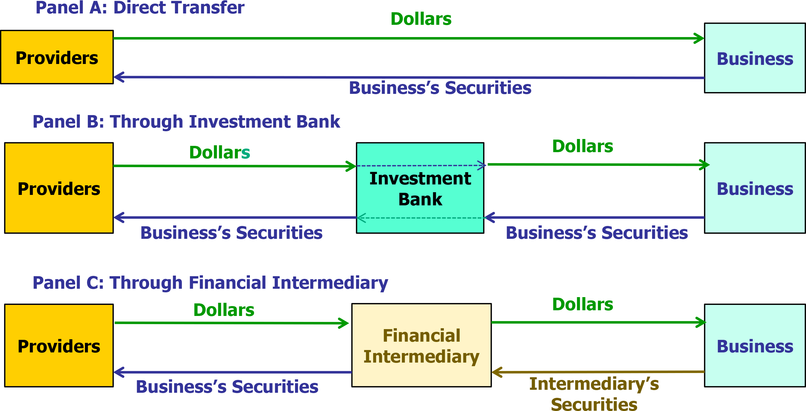
The Capital Allocation Process

Slide 27
Transfer of Capital from Savers to Borrowers
Direct transfer
Example: A corporation issues commercial paper to an insurance company.
Through an investment banking house
Example: In an IPO, seasoned equity offering, or debt placement, company sells security to investment banking house, which then sells security to investor.
Through a financial intermediary
Example: An individual deposits money in bank & gets certificate of deposit, bank makes commercial loan to a company (bank gets note from company).

Slide 28
Cost of Money (or required return)
What do we call price, or cost, of :
Debt capital?
= interest rate
Equity capital?
Cost of equity = Required return on equity= dividend yield + capital gain

Slide 29
What four factors affect cost of money?
Production opportunities
Time preferences for consumption
Risk
Expected inflation

Slide 30
What economic conditions affect cost of money?
Federal Reserve policies
Budget deficits/surpluses
Level of business activity (recession or boom)
International trade deficits/surpluses

Slide 31
What international conditions affect cost of money?
Country risk. Depends on country’s economic, political, & social environment.
Exchange rate risk. Non-dollar denominated investment’s value depends on what happens to exchange rate. Exchange rates affected by:
International trade deficits/surpluses
Relative inflation & interest rates
Country risk

Slide 32
What two factors lead to exchange rate fluctuations?
Changes in relative inflation will lead to changes in exchange rates.
An increase in country risk will also cause that country’s currency to fall.

Slide 33
What is a financial instrument?
Contractual obligation providing a claim on some future cash flow or asset.
Short-term financial instruments that mature within a year:
U.S. Treasury bills
Commercial paper
Certificates of Deposit (CDs)

Slide 34
Long-Term Financial Instruments (Payments for more than a year)
Commercial loans from banks
U.S. Treasury notes and bonds
Mortgages
Bonds
Corporate bonds
Municipal bonds (munis)
Preferred stock
Common stock

Slide 35
Financial Securities
 | Debt | Equity | Derivatives
Money Market | T-Bills CD’s Eurodollars Fed Funds |  | Options Futures Forward contract
Capital Market | T-Bonds Agency bonds Municipals Corporate bonds | Common stock Preferred stock | LEAPS Swaps

Slide 36
What is a financial institution?
Company that is intermediary between providers of funds and users of funds
Facilitates transfers of capital

Slide 37
What are some financial institutions?
Commercial banks
Investment banks
Savings & Loans, mutual savings banks, & credit unions
Life insurance companies
Mutual funds
Exchanged Traded Funds (ETFs)
Pension funds
Hedge funds & private equity funds

Slide 38
What are some types of markets?
A market is a method of exchanging one asset (usually cash) for another asset.
Physical assets vs. financial assets
Spot versus future markets
Money versus capital markets
Primary versus secondary markets

Slide 39
Primary vs. Secondary Security Sales
Primary
New issue (IPO or seasoned)
Key factor: issuer receives proceeds from sale.
Secondary
Existing owner sells to another party.
Issuing firm doesn’t receive proceeds & is not directly involved.

Slide 40
Key Features of Primary Markets
A new security is created.
Issuer receives proceeds from the sale of new security. Examples include:
Stocks sold to public in IPO
Seasoned equity offering after going public
Bonds sold to public by a company or government

Slide 41
Secondary Markets
Existing owner of a security sells it to another party.
Issuing firm is not directly involved.
There are secondary markets for:
Stocks
Bonds
Options

Slide 42
Secondary Markets are Important Because They:
Allow entrepreneurs to reap rewards by selling some of their stock and then:
Make new investments.
Improve their standards of living.
Provide liquidity for owners of securities.
Enable buyers/sellers to use prices to compare values of different investment alternatives.

Slide 43
How are secondary markets organized?
By “location”
Physical location exchanges
Computer/telephone networks
By way that orders from buyers & sellers are matched
Open outcry auction
Dealers (i.e., market makers)
Electronic communications networks (ECNs)

Slide 44
Physical Location vs. Computer/telephone Networks
Physical location exchanges: e.g., NYSE, AMEX, CBOT, Tokyo Stock Exchange
Computer/telephone: e.g., Nasdaq, government bond markets, foreign exchange markets

Slide 45
Types of Orders
Instructions on how a transaction is to be completed
Market Order– Transact as quickly as possible at current price
Limit Order– Transact only if specific situation occurs. For example, buy if price drops to $50 or below during next two hours.

Slide 46
Auction Markets
Participants have a seat on exchange, meet face-to-face, & place orders for themselves or for their clients; e.g., CBOT.
NYSE & AMEX are two largest auction markets for stocks.
NYSE is a modified auction, with a “specialist.”

Slide 47
Dealer Markets
“Dealers” keep an inventory of stock (or other financial asset) & place bid & ask “advertisements,” which are prices at which they are willing to buy & sell.
Often many dealers for each stock
Computerized quotation system keeps track of bid & ask prices, but does not automatically match buyers & sellers.
Examples: Nasdaq National Market, Nasdaq SmallCap Market, London SEAQ, German Neuer Markt.

Slide 48
Types of Orders from Clients
Market Order:
Transact as quickly as possible at current prices
Sell at the “bid” price offered by willing buyer.
Buy at the “ask” price offered by willing seller.
Limit Order
Transact only if specific situation occurs.
For example, buy if price drops to $50 or below during the next two hours.

Slide 49
How are orders from buyers and sellers matched and executed?
Traders meet face-to-face at open outcry auctions, such as the exchanges for derivative and option. A small amount of in-person trading take place at the NYSE.
Dealers (i.e., market makers) buy from and sell to clients from an inventory of stocks. Orders are usually, but not always, automatically matched by computers.
Automated trading platforms (i.e., computer networks) match orders and execute trades automatically.

Slide 50
Broker-Dealer Networks (1 of 2)
Register with the Securities and Exchange Commission (SEC), but less regulated than registered stock exchanges.
Broker-dealer can purchase stock being offered for sale by a client and then immediately sell it to another client who wishes to buy the stock.
Because broker-dealer is the counterparty to each of the clients, this is called internalization.

Slide 51
Broker-Dealer Networks (2 of 2)
Broker-dealer must report all transactions, but not any information prior to the trade, such as “bid prices” from potential buyers or “ask prices” from potential sellers.
Trades in broker-dealer networks are called “off exchange” or over-the-counter (OTC).
Trades can be with individuals (called retail trades) or with institutions.
Large trades (10,000 shares or more) are called block trades and are sometimes called “upstairs” trades.

Slide 52
Electronic Communications Networks (ECNs)
ECNs:
Computerized system matches orders from buyers & sellers & automatically executes transaction.
Low cost to transact
Examples: Instinet (US, stocks, owned by Nasdaq); Archipelago (US, stocks, owned by NYSE); Eurex (Swiss-German, futures contracts); SETS (London, stocks).

Slide 53
Over Counter (OTC) Markets
In old days, securities were kept in a safe behind counter, & passed “over counter” when they were sold.
Now OTC market is equivalent of a computer bulletin board (e.g., Nasdaq Pink Sheets), which allows potential buyers & sellers to post an offer.
No dealers
Very poor liquidity

Slide 54
Types of Investments Accounts: Full-Service Brokerage
Client has a human broker and/or advisor.
Usually requires minimum balance of $50,000 to $100,000.
Client pays relatively high fees.
Initial fee to open
Annual fees maintain the account
Commissions on trades, often based on size of trade.

Slide 55
Types of Investments Accounts: Online-only
Online-only brokerage accounts:
Client sends buy/sell orders to brokerage firm’s computer network.
Comparison to full-service brokerage account
Much less expensive
Much lower required minimum balance
No personal broker and fewer services provided
Does provides access to educational material

Slide 56
Types of Investments Accounts: Robo-Advisor Account
A type of online-only brokerage account
Client answers detailed questionnaire:
Current financial situation
Goals
Degree of risk tolerance
Computer creates investment strategy.
If client approves, computer executes strategy.

Slide 57
Types of Orders from Clients
Market Order:
Transact as quickly as possible at current prices
Sell at the “bid” price offered by willing buyer.
Buy at the “ask” price offered by willing seller.
Limit Order
Transact only if specific situation occurs.
For example, buy if price drops to $50 or below during the next two hours.

Slide 58
How are orders from buyers and sellers matched and executed?
Traders meet face-to-face at open outcry auctions, such as the exchanges for derivative and option. A small amount of in-person trading take place at the NYSE.
Dealers (i.e., market makers) buy from and sell to clients from an inventory of stocks. Orders are usually, but not always, automatically matched by computers.
Automated trading platforms (i.e., computer networks) match orders and execute trades automatically.

Slide 59
Broker-Dealer Networks (1 of 2)
Register with the Securities and Exchange Commission (SEC), but less regulated than registered stock exchanges.
Broker-dealer can purchase stock being offered for sale by a client and then immediately sell it to another client who wishes to buy the stock.
Because broker-dealer is the counterparty to each of the clients, this is called internalization.

Slide 60
Broker-Dealer Networks (2 of 2)
Broker-dealer must report all transactions, but not any information prior to the trade, such as “bid prices” from potential buyers or “ask prices” from potential sellers.
Trades in broker-dealer networks are called “off exchange” or over-the-counter (OTC).
Trades can be with individuals (called retail trades) or with institutions.
Large trades (10,000 shares or more) are called block trades and are sometimes called “upstairs” trades.

Slide 61
Alternative Trading System (ATS)
A broker-dealer registers with the SEC to be an Alternative Trading System (ATS).
ATS usually has an automated trading platform to match orders from clients.
Owner of the ATS is not always the counterparty, in contrast to a broker-dealer network.
The ATS must report trades, but not any pre-trade information.
Therefore, an ATS is often called a dark pool.

Slide 62
Trade Reporting Facility (TRF) (1 of 2)
A Trade Reporting Facility (TRF) is an online system set up by a stock exchange to report off-exchange trading of its listed stocks.
There are three TRFs, one for each major stock exchange.
A TRF applies quality control measures to ensure data’s accuracy.

Slide 63
Trade Reporting Facility (TRF) (2 of 2)
Reports data to the Consolidated Tape Association (CTS)
Gathers stock exchange data
Applies quality control processes to ensure the data’s accuracy
Then releases the data

Slide 64
Financial Crisis of 2008

Slide 65
Home Mortgages Before S&Ls
problems if an individual investor tried to lend money to an aspiring homeowner:
Individual investor might not have enough money to fund an entire home
Individual investor might not be in a good position to evaluate risk of potential homeowner
Individual investor might have difficulty collecting mortgage payments

Slide 66
S&Ls Before Securitization
Savings & loan associations (S&Ls) solved problems faced by individual investors
S&Ls pooled deposits from many investors
S&Ls developed expertise in evaluating risk of borrowers
S&Ls had legal resources to collect payments from borrowers

Slide 67
Problems faced by S&Ls Before Securitization
S&Ls were limited in amount of mortgages they could fund by amount of deposits they could raise
S&Ls were raising money through short-term floating-rate deposits, but making loans in form of long-term fixed-rate mortgages
When interest rates increased, S&Ls faced crisis because they had to pay more to depositors than they collected from mortgagees

Slide 68
Taxpayers to Rescue
Many S&Ls went bankrupt when interest rates rose in 1980s.
Because deposits are insured, taxpayers ended up paying hundreds of billions of dollars.

Slide 69
Securitization in Home Mortgage Industry
After crisis in 1980s, S&Ls now put their mortgages into “pools” & sell pools to other organizations, such as Fannie Mae.
After selling a pool, S&Ls have funds to make new home loans
Risk is shifted to Fannie Mae

Slide 70
Fannie Mae Shifts Risk to Its Investors
Risk hasn’t disappeared, it has been shifted to Fannie Mae.
But Fannie Mae doesn’t keep mortgages:
Puts mortgages in pools, sells shares of these pools to investors
Risk is shifted to investors.
But investors get a rate of return close to mortgage rate, which is higher than rate S&Ls pay their depositor.
Investors have more risk, but more return
This is called securitization, since new securities have been created based on original securities (mortgages in this example)

Slide 71
Collateralized Debt Obligations (CDOs)
Fannie Mae & others, such as investment banks, can also split mortgage pools into “special” securities
Some securities might pay investors only mortgage interest, others might pay only mortgage principal.
Some securities might mature quickly, others might mature later.
Some securities are “senior” & get paid before other securities from pool get paid.
Rating agencies give different
Risk of basic mortgage is parceled out to those investors who want that type of risk (& potential return that goes with it).

Slide 72
Other Assets Can be Securitized
Car loans
Student loans
Credit card balances

Slide 73
Dark Side of Securitization
Homeowners wanted better homes than they could afford.
Mortgage brokers encouraged homeowners to take mortgages even though they would reset to payments that borrowers might not be able to pay because brokers got a commission for closing deal.
Appraisers thought real estate boom would continue & over-appraised house values, getting paid at time of appraisal.
Originating institutions (like Countrywide) quickly sold mortgages to investment banks & other institutions.

Slide 74
Dark Side (Continued)
Investment banks created CDOs & got rating agencies to help design & then rate new CDOs, with rating agencies making big profits despite conflicts of interest.
Financial engineers used unrealistic inputs to generate high values for CDOs.
Investment banks sold CDOs to investors & made big profits.
Investors bought CDOs but either didn’t underst& or care about risk.
Some investors bought “insurance” via credit default swaps.

Slide 75
Collapse
When mortgages reset & borrowers defaulted, values of CDOs plummeted.
Many of credit default swaps failed to provide insurance because counterparty failed.
Many originators & securitizers still owned sub-prime securities, which led to many bankruptcies, government takeovers, & fire sales, including:
New Century, Countrywide, IndyMac, Northern Rock, Fannie Mae, Freddie Mac, Bear Stearns, Lehman Brothers, & Merrill Lynch.
More to come.

